Slide 1
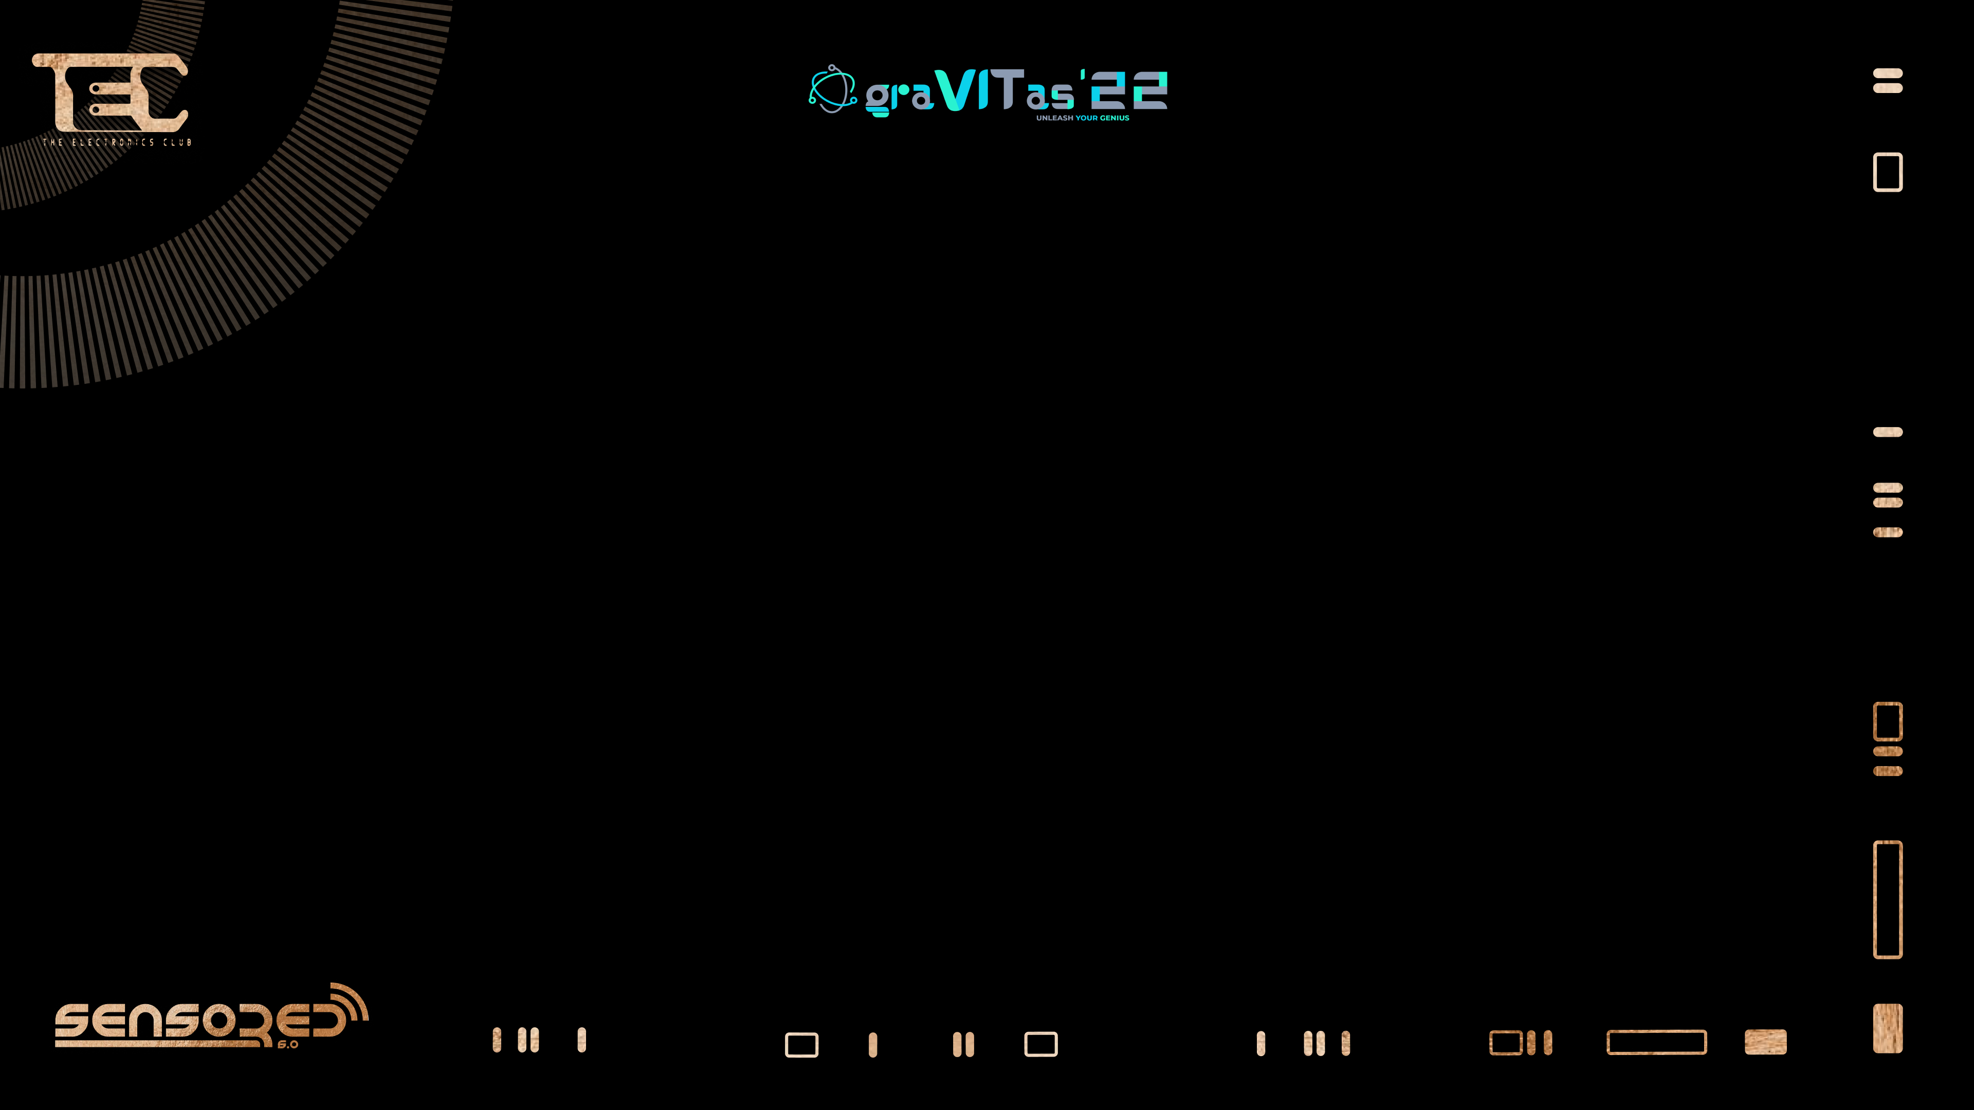


Slide 2
ANALOG TO DIGITAL CONVERTER (ADC)

Slide 3

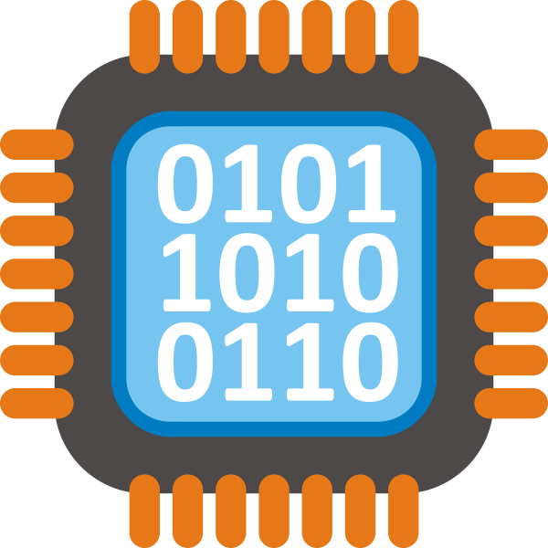

TYPES OF SIGNALS
ANALOG SIGNAL
DIGITAL SIGNAL
Notes:
Telephone communica

Slide 4

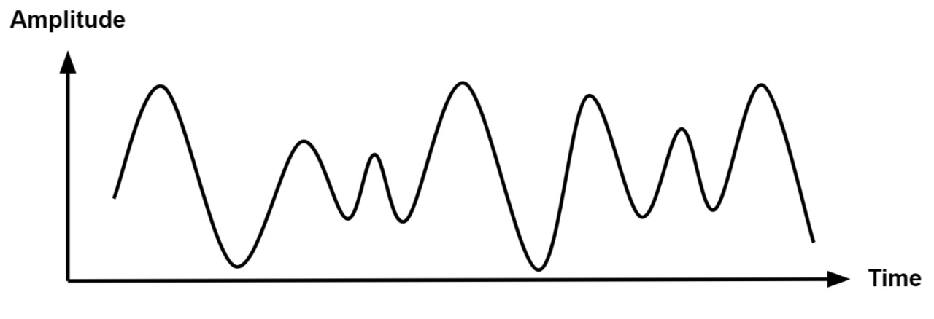
ANALOG SIGNAL
An analog signal is any continuous signal representing some other quantity, i.e., analogous to another quantity.
Notes:
Analogous quantities like distance, sound, temperature, etc.

Slide 5
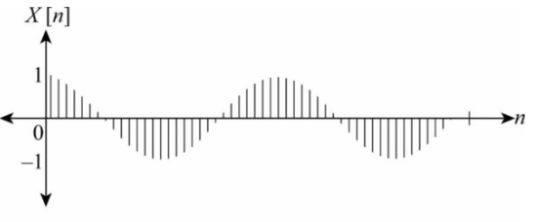
DISCRETE SIGNAL
A discrete signal or discrete-time signal is a time series consisting of a sequence of quantities.

Slide 6
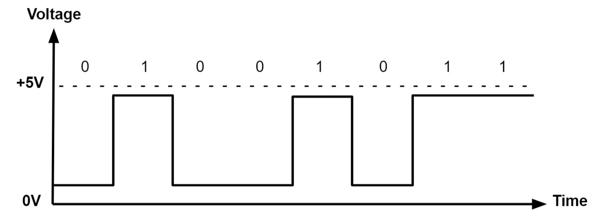
DIGITAL SIGNAL
A digital signal is a signal that represents data as a sequence of discrete values; at any given time it can only take on, at most, one of a finite number(0,1)

Slide 7
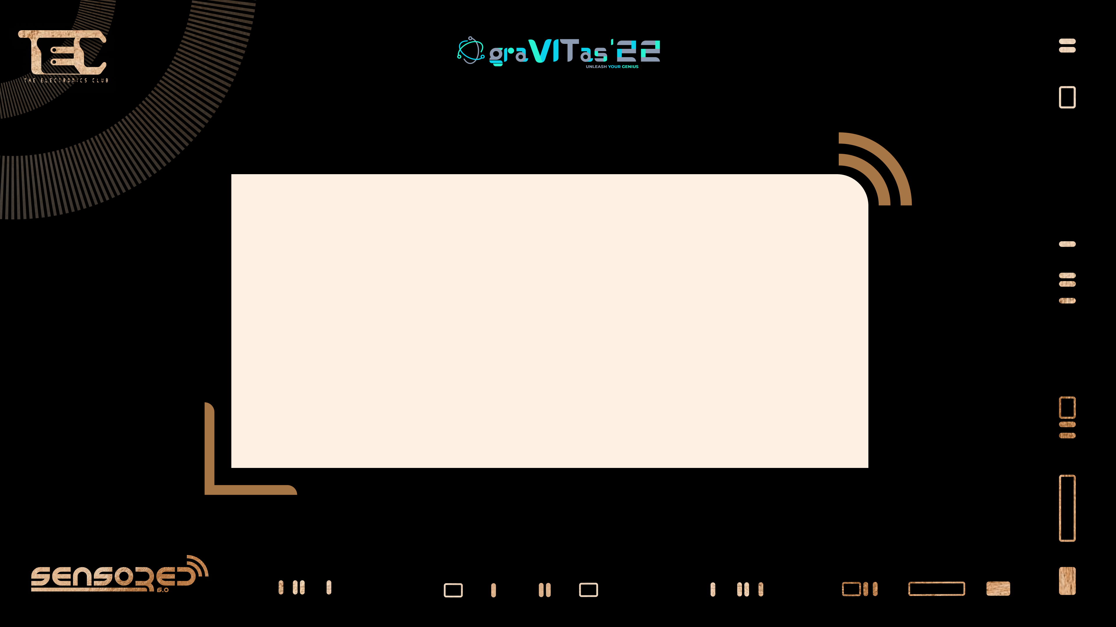

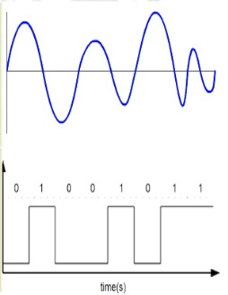
WHY IS AN ADC REQUIRED?

Slide 8
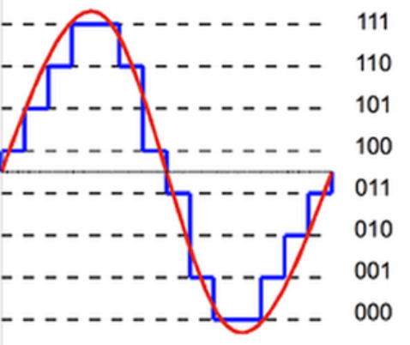
ANALOG SIGNAL VS DIGITAL SIGNAL
(7)
(6)
(5)
(4)
(3)
(2)
(1)
(0)
Notes:
Bits are least basic unit of information in communication.

Slide 9

HOW DO WE CONVERT AN ANALOG SIGNAL TO DIGITAL SIGNAL?

Slide 10
It has a three step process called SQE.
It includes: -
Sampling
Quantisation
Encoding

Slide 11
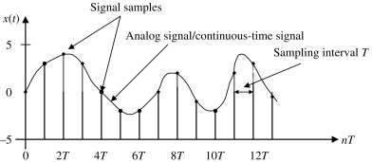
SAMPLING
Sampling is a process of measuring the amplitude of a continuous-time signal at discrete instants, converting the continuous signal into a discrete signal.
The black lines towards the x-axis is a sample.

Slide 12
TYPES OF SAMPLING
There are three types of Sampling: -
Under Sampling
Critical Sampling
Over Sampling.
Nyquist rate: - F_{s} ≥ 2F_{m}

Slide 13

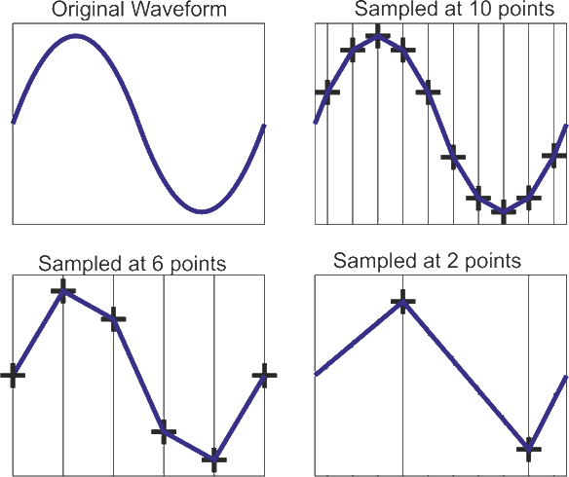
ACCURACY

Slide 14
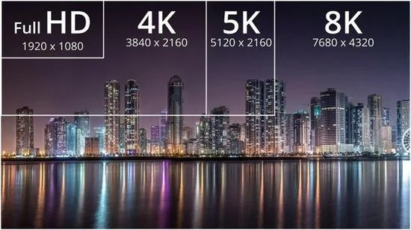

RESOLUTION

Slide 15
Resolution of an ADC is how accurately it will sample (convert) the analog electronic signals into digital values (i.e. 0s and 1s).
Higher is the resolution then greater will be the accuracy.
No. of levels =2^{Resolution}

Slide 16

QUANTISATION

Slide 17
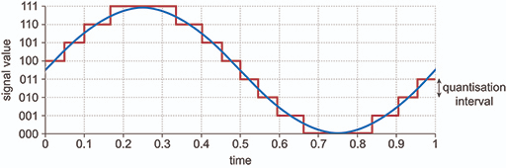
Quantization is the process of mapping continuous amplitude (analog) signals into discrete amplitude (digital) signals. .

Slide 18
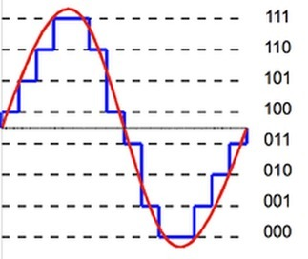
ENCODING
Encoding is converting of discrete values to binary values.
8-bit encoder to 8-bits of binary digits

Slide 19
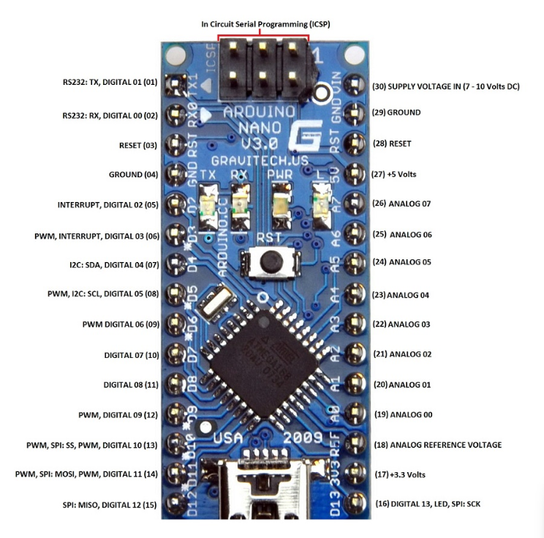
ADC IN ARDUINO NANO
8 analog input pins
It has 10-bit ADC Will give digital value in the range of 0 – 1023
Function for analog input: analogRead()

Slide 20
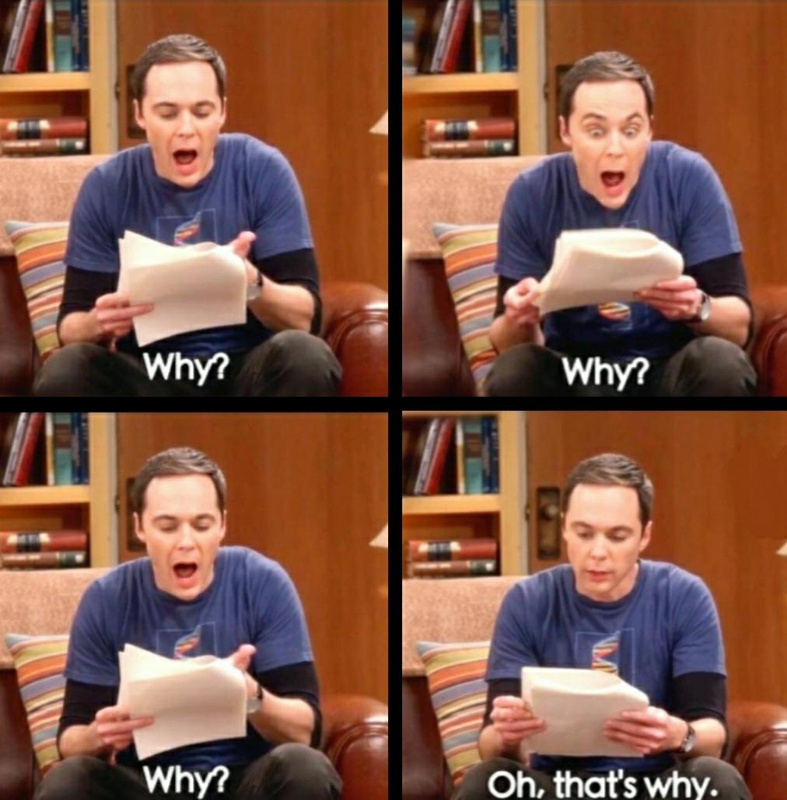
DIGITAL TO ANALOG CONVERTER

Slide 21

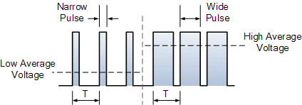
PULSE WIDTH MODULATION(PWM)
PWM is a method of reducing the average power delivered by an electrical signal by getting it into discrete parts.
Notes:
Transmitter to receiver
Modulation is process of changing the characteristics of carrier signal in accordance to message signal.

Slide 22
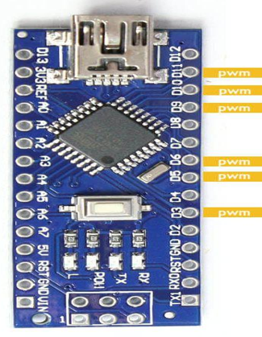
PWM OUTPUT PINS IN ARDUINO NANO
6 PWM output pins.
Pin no. 3, 5, 6, 9, 10, 11
Denoted by a ‘ ~ ’
Syntax for analog output:
analogWrite()

Slide 23
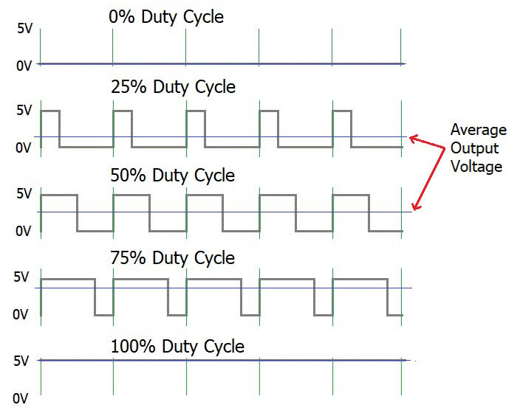
DUTY CYCLE
A duty cycle is the fraction of one period when a system or signal is active.
T_{ON}
T_{ON} + T_{OFF}
Duty Cycle =
X 100%
Notes:
Percentage of time the signal is active.

Slide 24
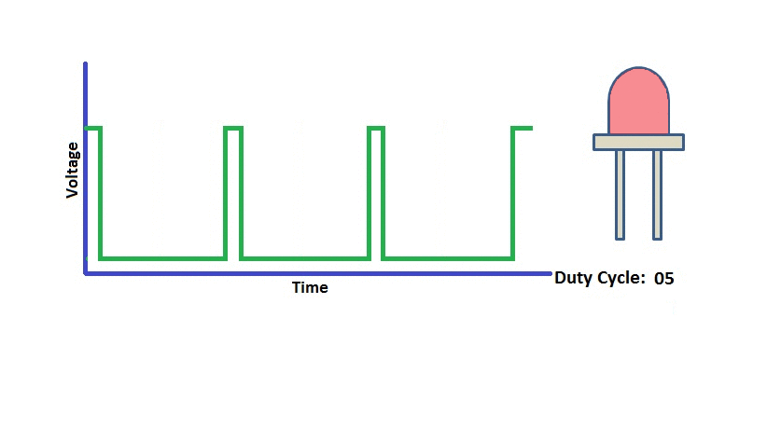

Slide 25
PATTERN BLINKING USING ARDUINO NANO

Slide 26
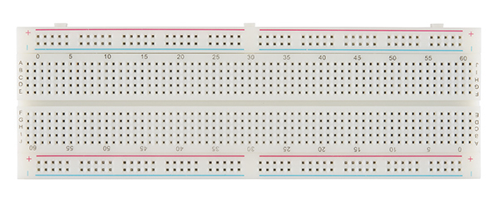
WHAT IS A BREADBOARD?

Slide 27
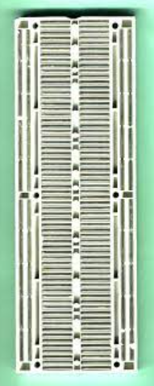

Slide 28
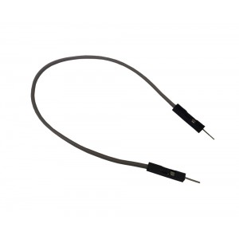
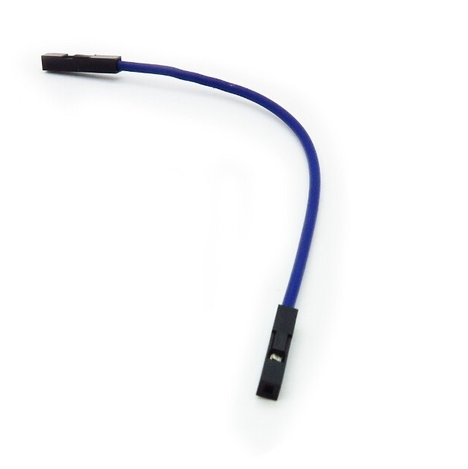

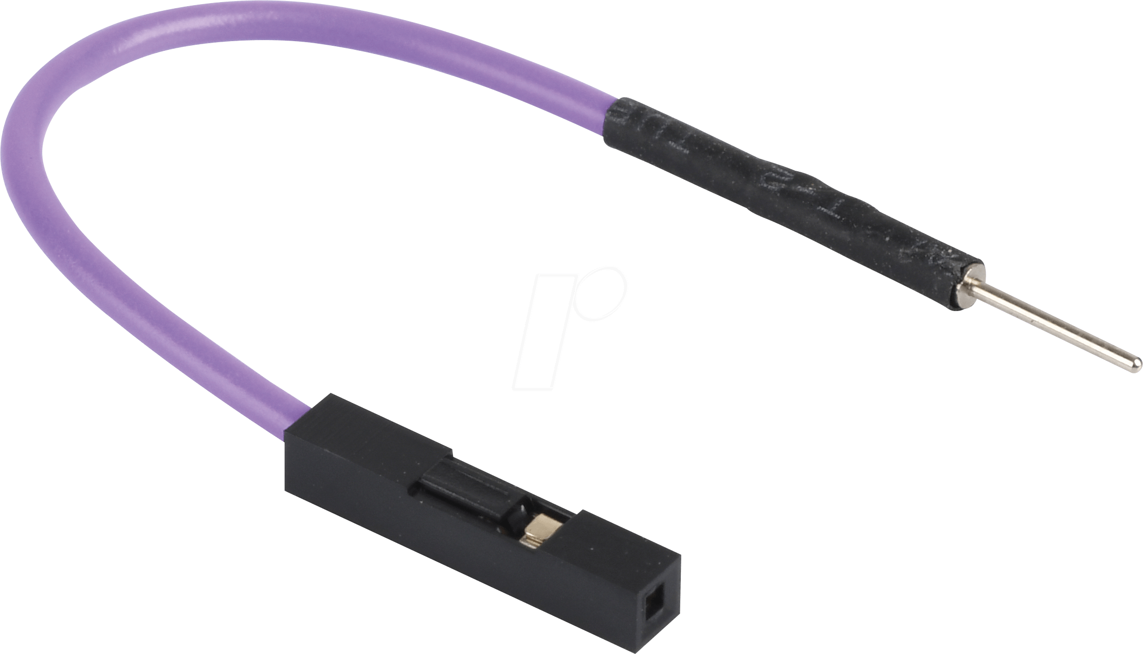
JUMPER CABLES
MALE TO FEMALE
FEMALE TO FEMALE
MALE TO MALE

Slide 29
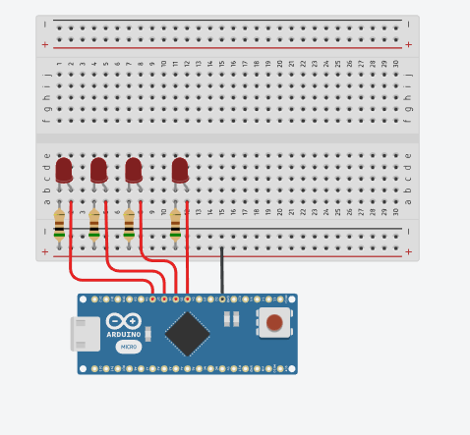
CIRCUIT DIAGRAM

Slide 30
CODE FOR PATTERN BLINKING
void setup()
{
pinMode(4, OUTPUT);
pinMode(5, OUTPUT);
pinMode(6, OUTPUT);
pinMode(7, OUTPUT);
}

Slide 31
void loop() {
digitalWrite(4, HIGH);
delay(100); // Wait for 100 millisecond(s)
digitalWrite(5, HIGH);
delay(100); // Wait for 100 millisecond(s)
digitalWrite(6, HIGH);
delay(100); // Wait for 100 millisecond(s)
digitalWrite(7, HIGH);
delay(100); // Wait for 100 millisecond(s)

Slide 32
digitalWrite(4, LOW);
delay(100); // Wait for 100 millisecond(s)
digitalWrite(5, LOW);
delay(100); // Wait for 100 millisecond(s)
digitalWrite(6, LOW);
delay(100); // Wait for 100 millisecond(s)
digitalWrite(7, LOW);
delay(100); // Wait for 100 millisecond(s)
}

Slide 33

SPEAKERS: -
ASHWIN KULKARNI SIDDHANT BHUSHAN

